Slide 1

UFO scrubbed dataset
Charlie-Jade
And Maryam

Slide 2

Loading datasets
Change xlsx to csv
Name changed from cleaned
to scrubbed
Use working directory
Absolute vs. relative pathway
read.csv()
View()
Notes:
Manually changed xlsx to csv and saved it

Slide 3
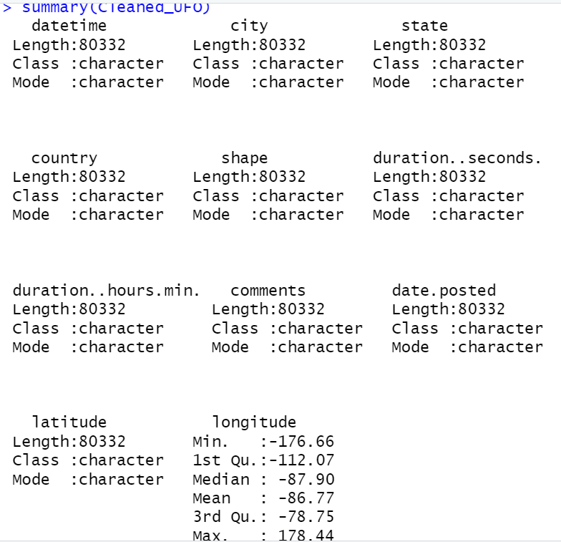
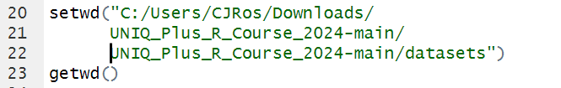
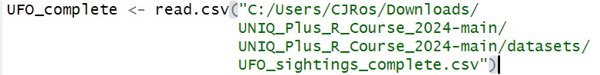
Relative vs. absolute path
Relative
Cleaned_UFO <- read.csv("../datasets/UFO_sightings_scrubbed.csv")
View(Cleaned_UFO)
summary(Cleaned_UFO)
Absolute

Slide 4
Use of base R

Slide 5


Understanding the dataset
Returns the unique values in the ‘country’ column.
?????????

Slide 6
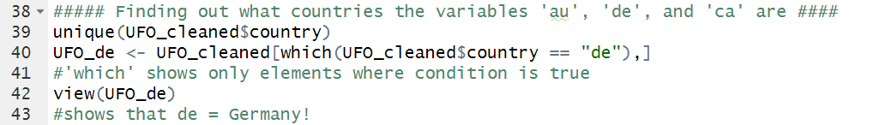
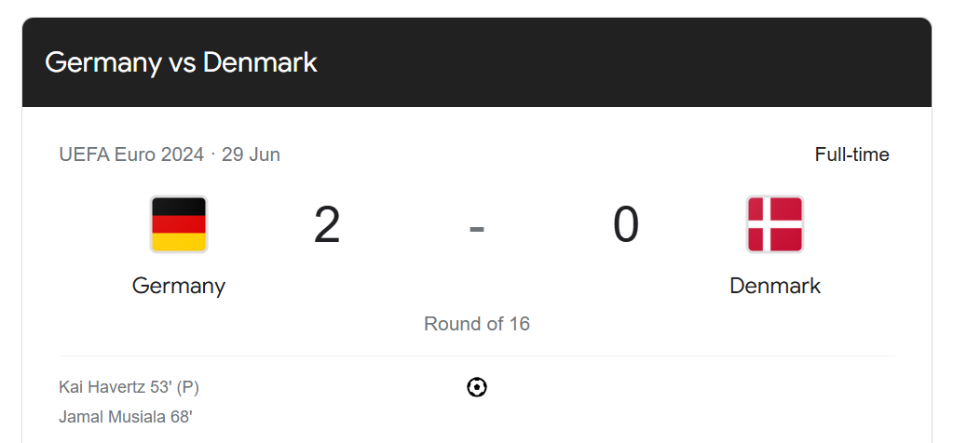

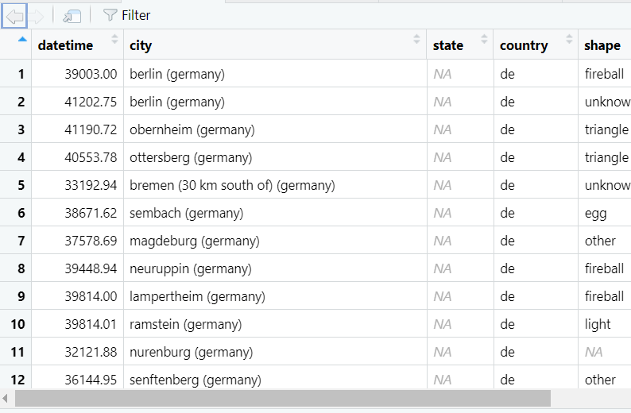

Slide 7
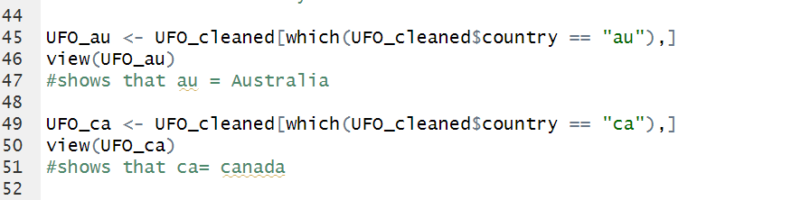
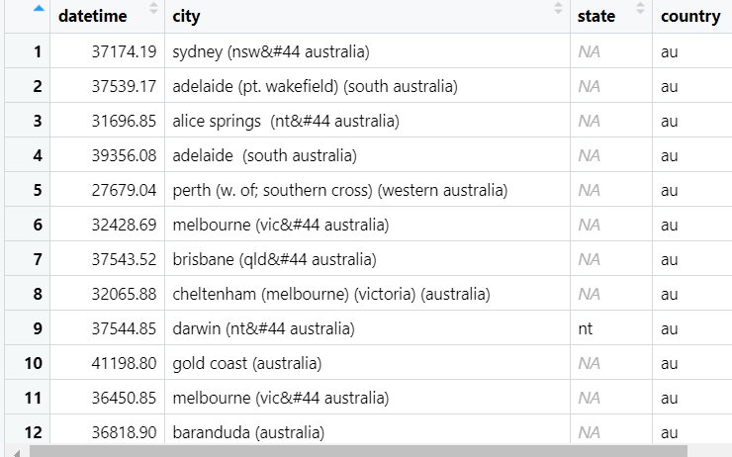
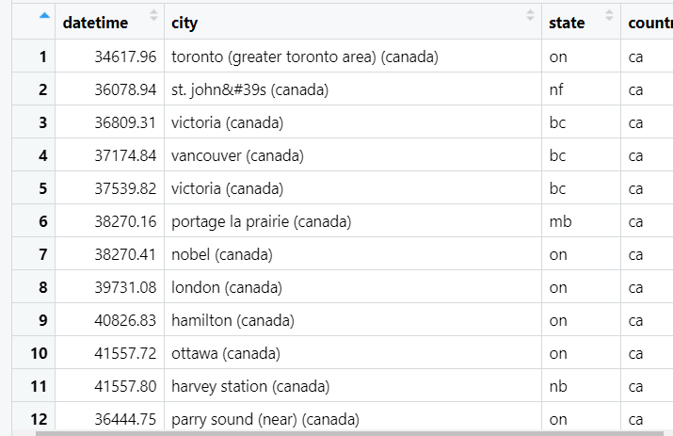

Slide 8
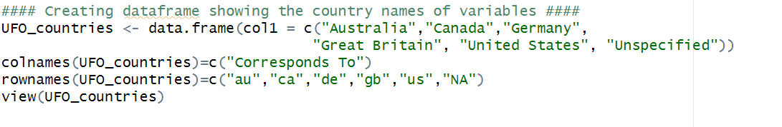
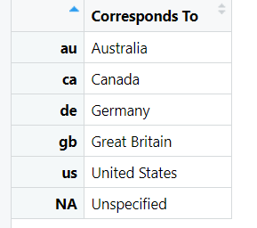
Making things easier for future research

Slide 9
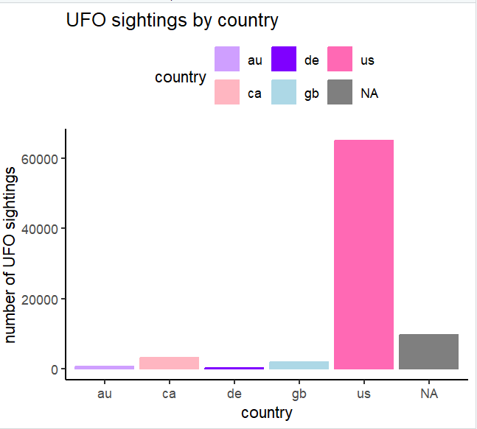
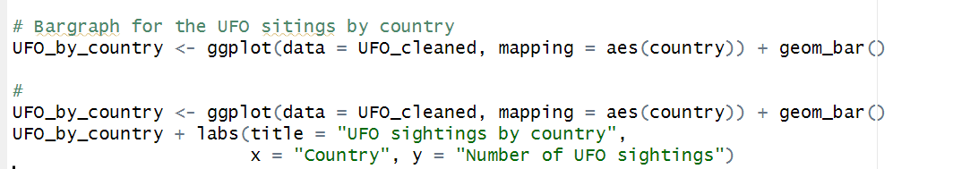

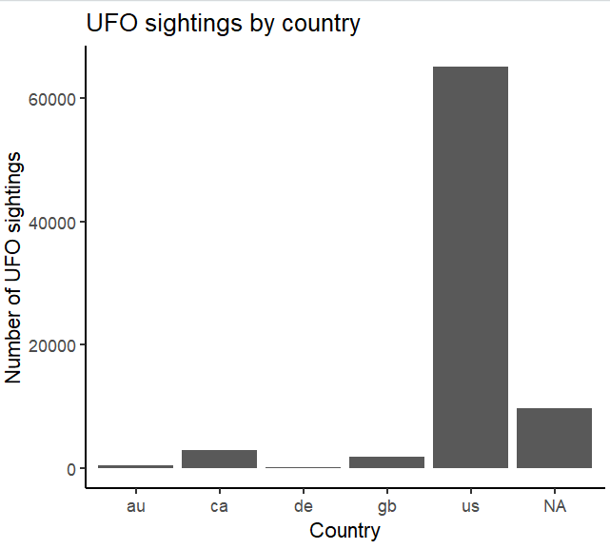
Limitations of the data
Who needs magic
when you have….
Data
visualisation
packages

Slide 10
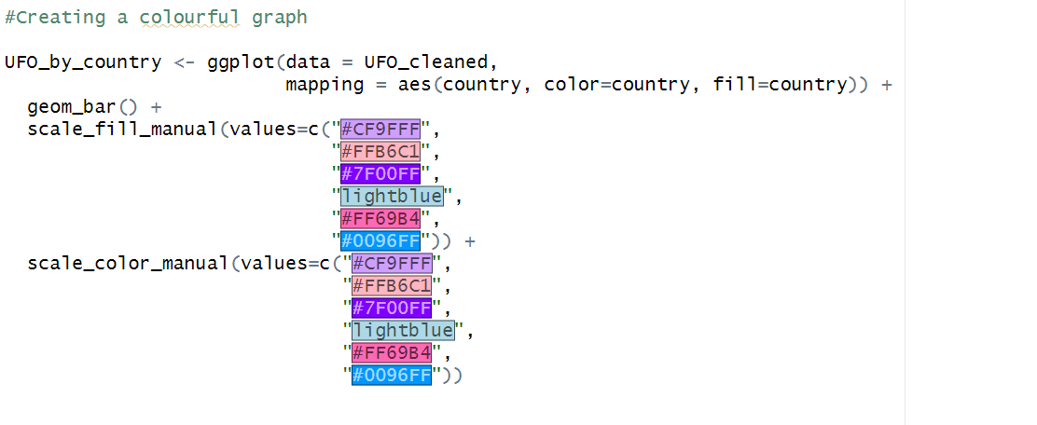

Slide 11
More analysis of the data via R packages

Slide 12
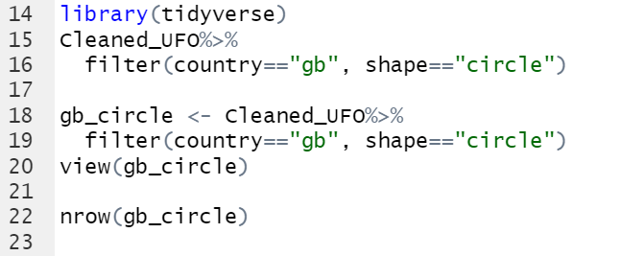
How many circle UFOs were spotted in gb via filtering

Slide 13
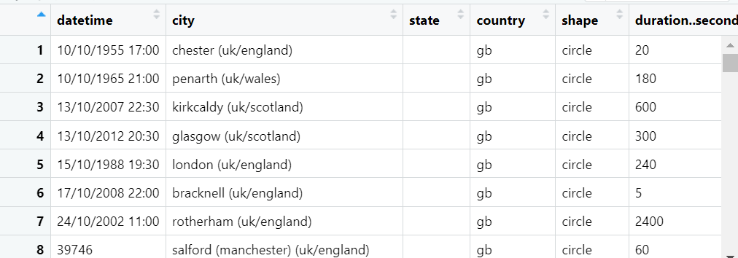
Output

Slide 14
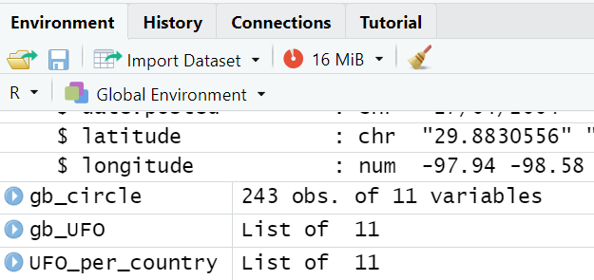

How many?

Slide 15
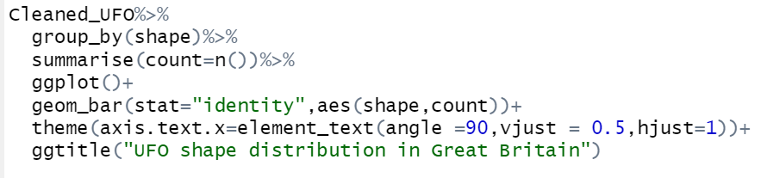
Analysing the different shapes via group_by

Slide 16
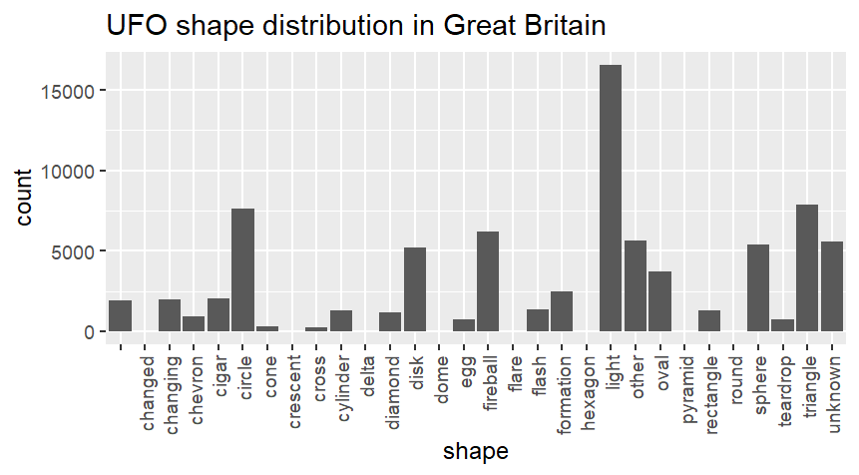
The bar graph

Slide 17
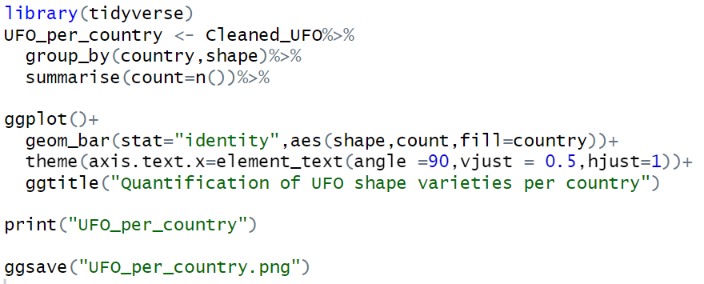
Using piping then group data and plot
Cleaned_UFO <- read.csv("../datasets/UFO_sightings_scrubbed.csv")
View(Cleaned_UFO)
library(tidyverse)
Cleaned_UFO%>%
# filter(country=="gb") %>%
group_by(country,shape)%>%
summarise(count=n())%>%
ggplot()+
geom_bar(stat="identity",aes(shape,count,fill=country))+
theme(axis.text.x=element_text(angle =90,vjust = 0.5,hjust=1))

Slide 18
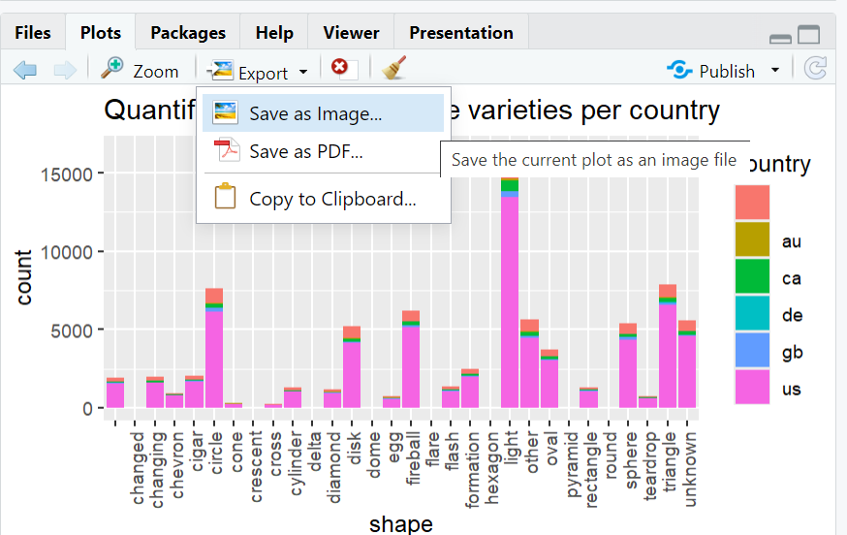
Saving image manually

Slide 19
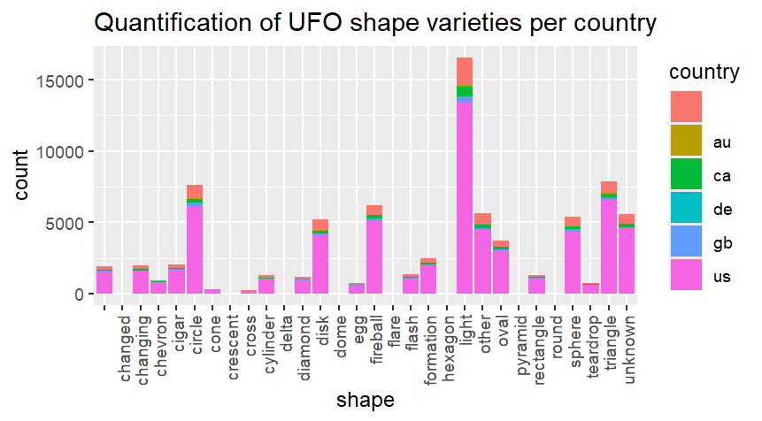
Ggplot2 graph

Slide 20
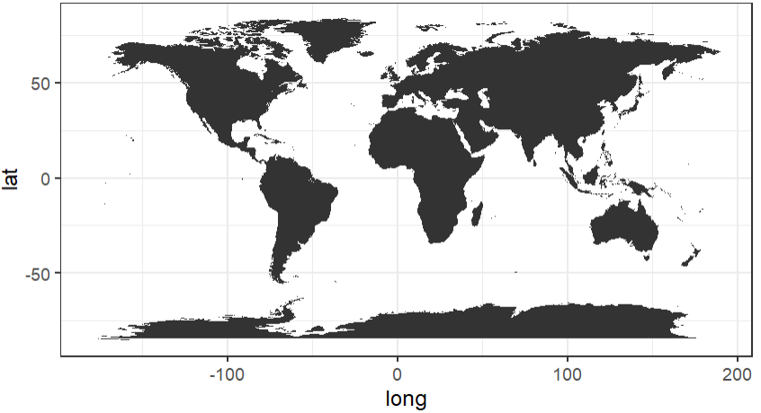

Slide 21
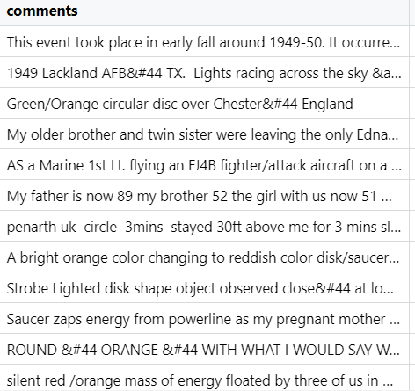
Handling qualitative data

Slide 22

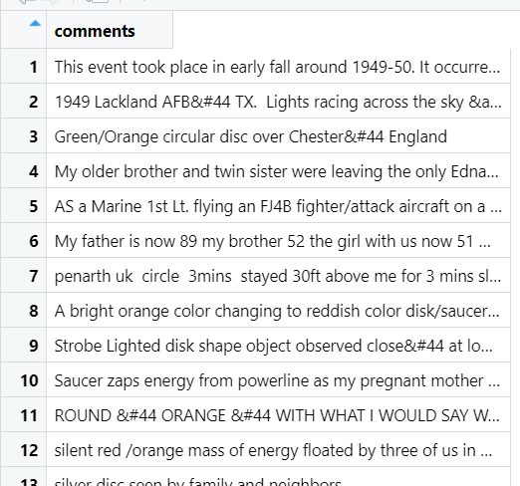

Slide 23
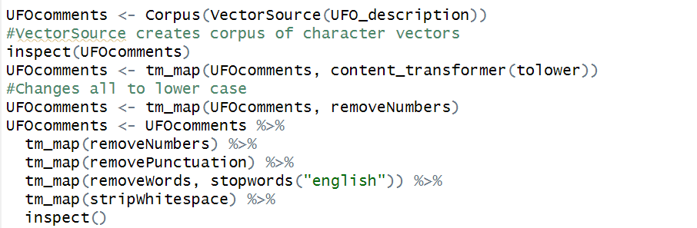
Text corpus - large collection of textual data
Using the ‘tm’ package, for text mining

Slide 24
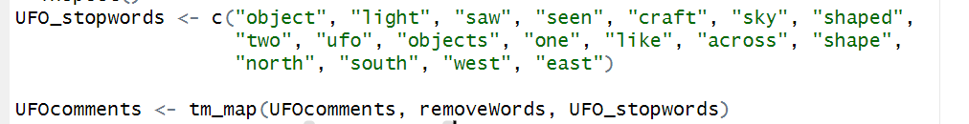
Removing specific words with a custom vector
More efficient way to do this?

Slide 25
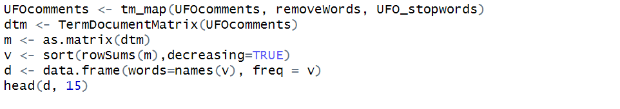
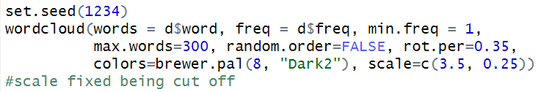
Generating the wordcloud
Has highest frequency words appear at the top
Easily see which words are the most frequent
Use dev.off() after the graph I plotted earlier, also stopped the word cloud being cut off.

Slide 26
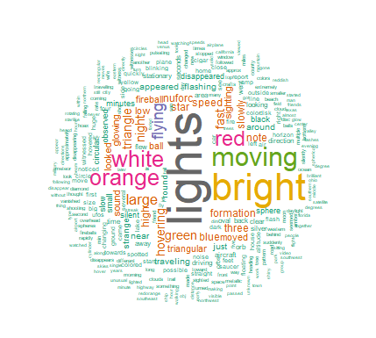

Voila!!
If change “Dark2” to “PuRd”

Slide 27
Key takeaways
Makes data visualisation and analysis much easier
Most importantly - trial and error get you a long away

Slide 28
Thank you!!

